Slide 1
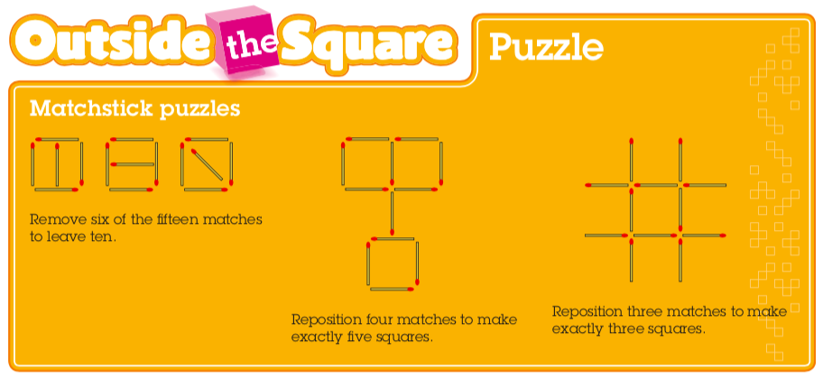
Mental maths

Slide 2
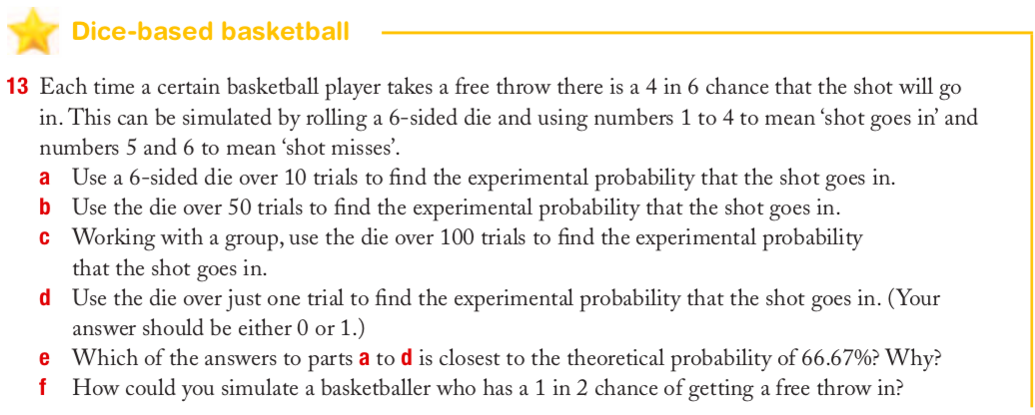
Review from last class – Work with a partner

Slide 3
Topic: Probability
EQ: What is the difference between theoretical and experimental probability?

Slide 4
Activity
Theoretical vs Experimental Probability Hands On Activity
You will need:
A partner (no more than groups of 3)
A paper clip
A sharp pencil or push pin (see video)
Coloured pencils if you’d like to colour spinner
Notes:
Independent practice

Slide 5
Paper clip spinner How-to Video
https://www.youtube.com/watch?v=_Dj1yQt_yas

Slide 6
Class/Homework
Essentials Mathematics Gold 7
Chapter 8: Statistics and Probability
Monopoly Investigation

